Slide 1

LIBRARY MANAGEMENT SYSTEM

Slide 2

TEAM CONTRIBUTION
*Developed the module to add GOOGLE Library books using Python.
*Implemented the Login ID system for user authentication.
01
*Created the Client Login feature for users.
*Designed the Menu-Driven Interface for easy navigation.
02
*Developed the Search Functionality to find books easily.
*Implemented the Feedback System for user reviews and suggestions.
03

Slide 3
04
*Managed the Admin Module for overall control of the system.
*Implemented Penalty Amount Calculation for overdue books.
05
*Created the feature for Due Date Extension of borrowed books.
*Developed the Borrow History module to track user activity.

Slide 4
INTRODUCTION
The Library Management System is a Python-based application designed to simplify and automate the day-to-day operations of a library.
It helps in managing books, user information, borrowing and returning processes, and fine calculation in an efficient way.
The system allows users to easily search, borrow, and return books, while the admin can monitor records, penalties, and feedback.
By using this system, the traditional manual library work is replaced with a digital and organized method that saves time and reduces errors.

Slide 5
Tools and Technologies Used
Programming Language: Python
Libraries/Modules Used:
  csv – for storing and managing data
  datetime – for handling due dates and penalties
  os – for file operations and interface clearing
Data Storage: CSV files (used as a local database)
IDE / Code Editor: Visual Studio Code (VS Code)
Platform: Windows / Linux (cross-platform compatible)
Version Control (Optional): Git / GitHub

Slide 6
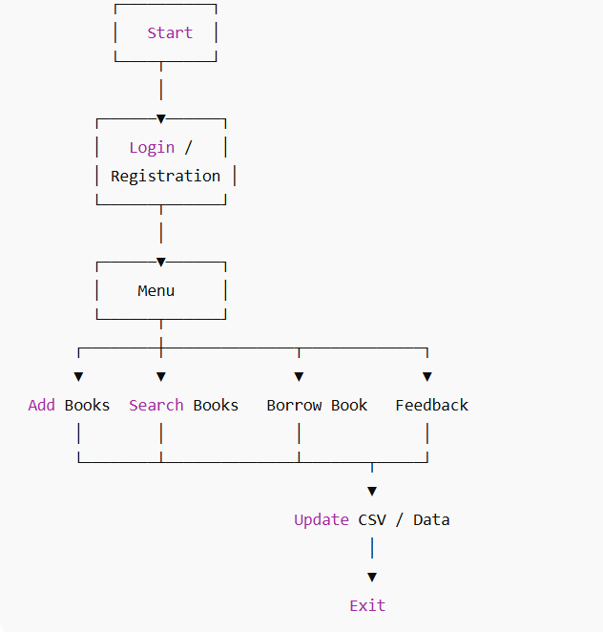
FLOW CHART

Slide 7
Start
Login / Register (Student, Faculty, or Admin)
Menu Display
Add GOOGLE Library Books
Search Books
Borrow / Return Books
Extend Due Date
View Borrow History
Feedback
Exit
Perform Selected Operation
Store or Update Data in CSV
Return to Main Menu
Exit / End

Slide 8
Working / Implementation
The Library Management System is implemented using the Python programming language, which provides simplicity, flexibility, and ease of handling data.
All information such as book details, user data, borrow records, penalties, and feedback are stored in CSV (Comma-Separated Values) files, which act as the project’s local database.
The system provides separate access levels for different types of users — Admins and Students/Faculty (Clients).
Admins have complete control over the system. They can add new books from the GOOGLE Library, manage users, view borrow history, extend due dates, and handle penalty calculations.
Users (Students/Faculty) can log in to search for books, borrow and return them, request due date extensions, and provide feedback.
The program uses a menu-driven interface, allowing users to easily navigate through different options.
Each operation (like adding a book, borrowing, or returning) automatically updates the corresponding CSV file, ensuring that all records are accurate and up to date.
This implementation makes the system lightweight, efficient, and easy to maintain, even without an external database.

Slide 9
Login Phase:
The user (student, faculty, or admin) logs in using their Login ID.
Menu Display:
After login, a menu-driven interface appears with options like Add Books, Search Books, Borrow, Return, Feedback, etc.
Book Management:
Admin or authorized users can add VIT Library books to the system.
Each book is stored in a CSV file with details like title, author, and availability.
Borrow and Return:
Users can borrow books and the system records the borrow date and due date.
If the book is returned late, a penalty amount is calculated automatically.
Feedback System:
Users can give feedback or suggestions that are stored for the admin to review.
Admin Operations:
The admin can manage all user activities, view borrow history, and extend due dates if needed.
Data Storage:
All records (books, users, borrow history, and feedback) are saved in CSV files, ensuring persistence of data even after the program is closed.

Slide 10
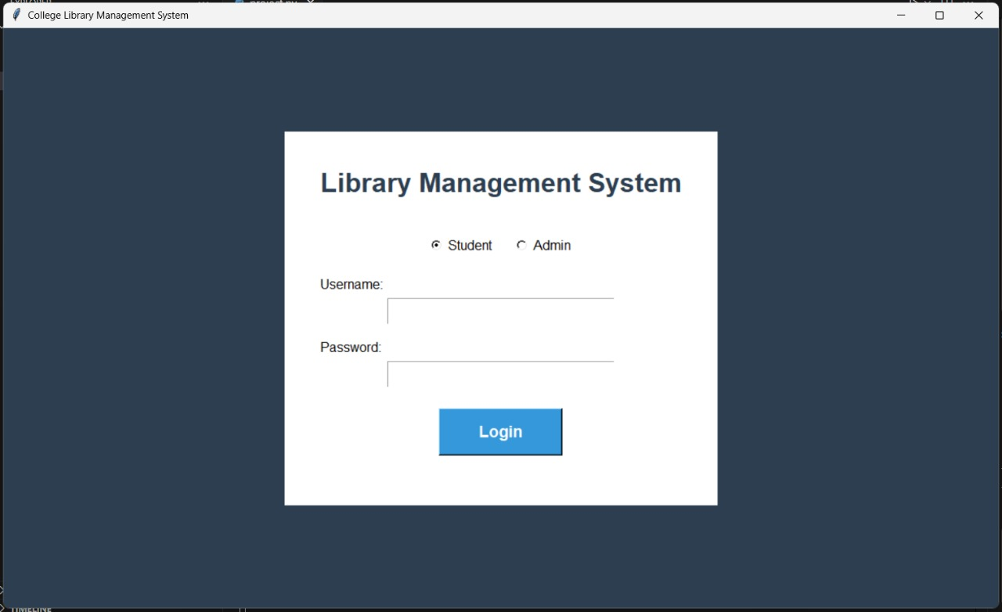
LOGIN PAGE

Slide 11
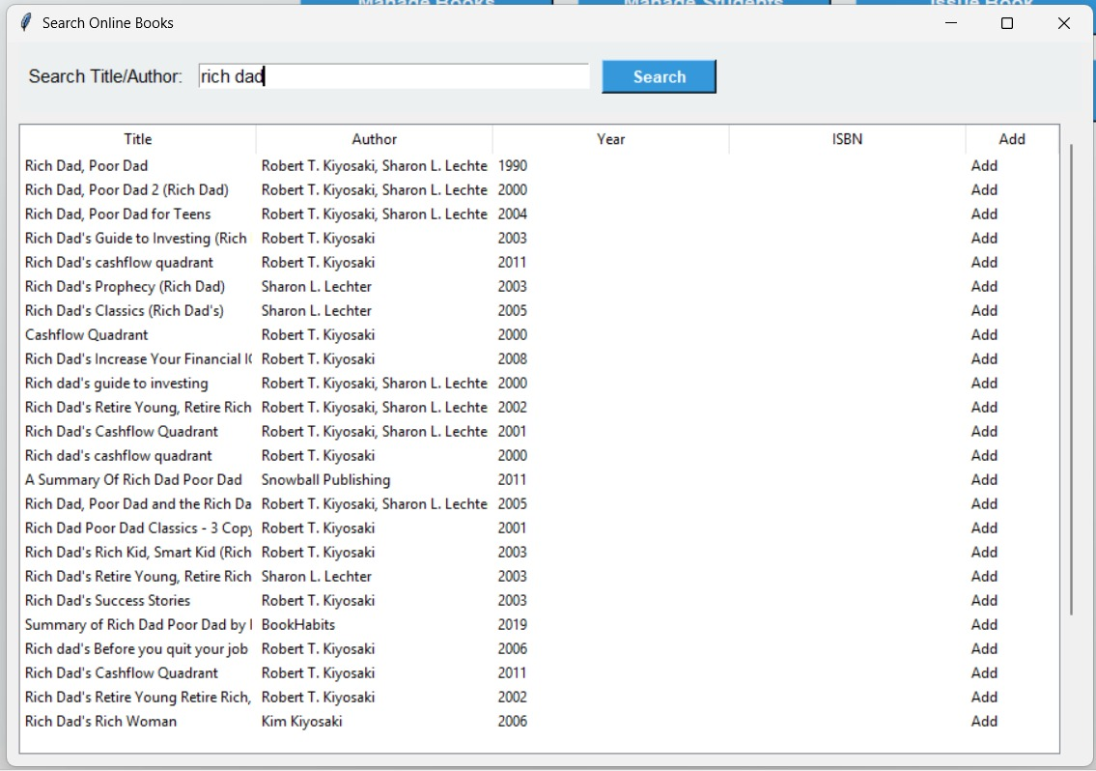
SEARCH ONLINE BOOKS

Slide 12
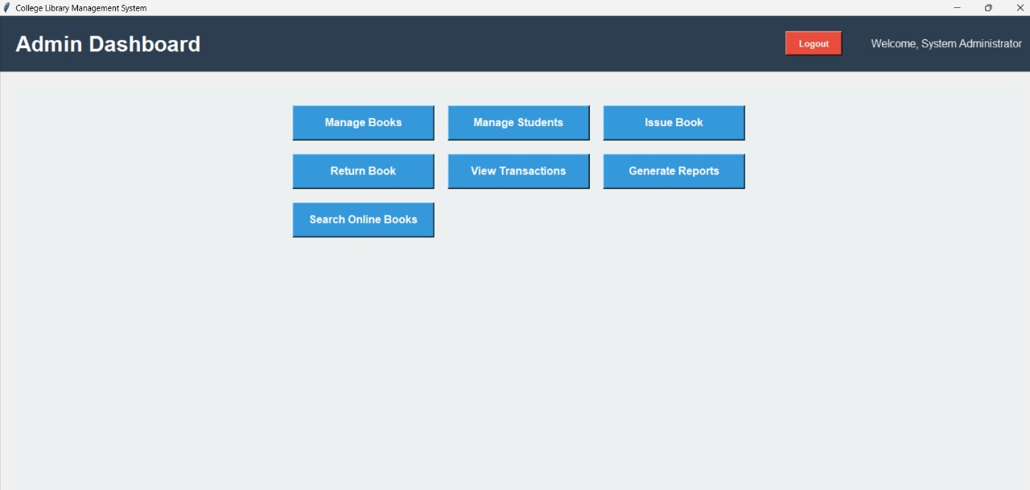
ADMIN DASHBOARD

Slide 13
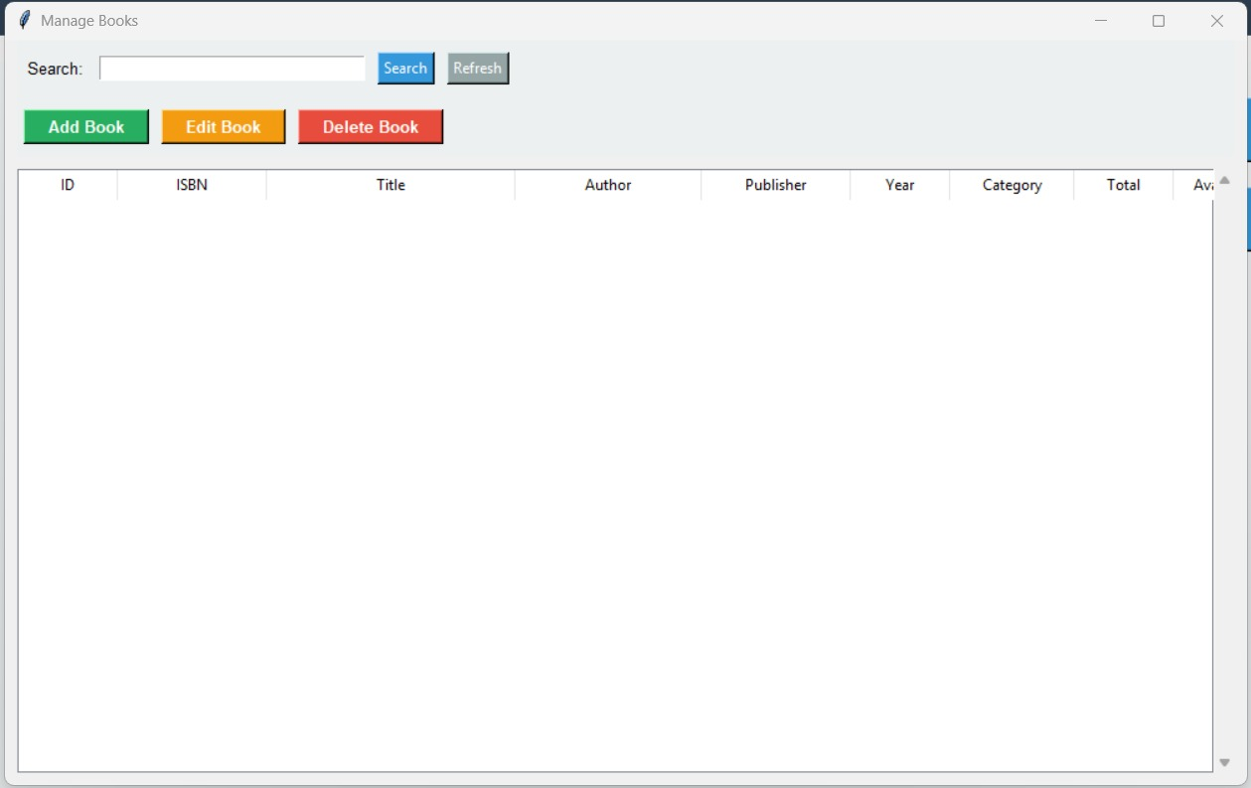
MANAGE BOOKS

Slide 14
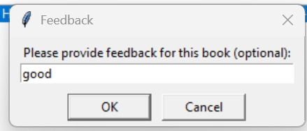
FEEDBACK

Slide 15
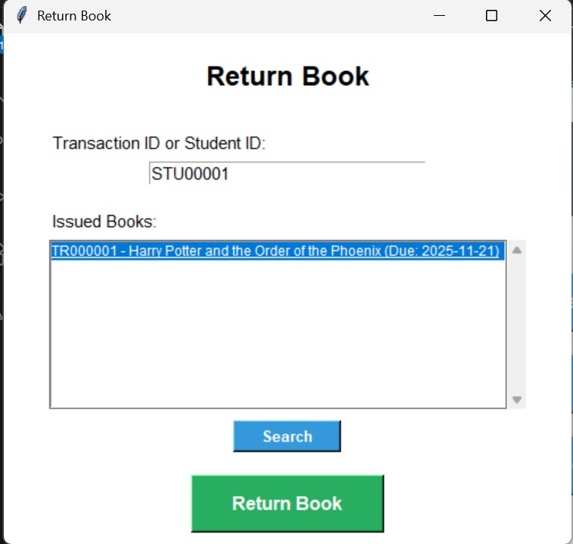
RETURNING BOOKS

Slide 16
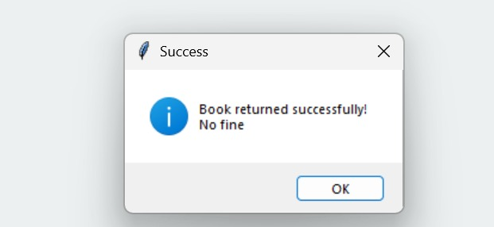

Slide 17
TEAM MEMBERS
RAGESH.E(25BBS0155)
LOKESH.D(25BCE2929)
SURYALALANA.S(25BCE2910)
HARIHARAAN MYTHILI BALASUBRAMANIAN(25BBS0150)
ISUKAPALLI VENKATA RAMA SAI MAITHREYA(25BCE2715)

